Slide 1
Psycological Counselling

Slide 2

Welcome to this short presentation introducing the Psychological Counselling at Universität Hamburg.
This is a PowerPoint presentation set to audio. Please start the presentation mode.
Duration: about 10 minutes
Notes:
Welcome to this short presentation introducing the Psychological Counselling provided by the University Hamburg. The presentation will be about 15 minutes. It will give you an overview of what this institution offers and how you can sign up.

Slide 3

Our team
10 psychologists (M.Sc and diploma)
All legally qualified to practice psychotherapy or currently preparing for the licence
Behaviour, Systemic or Psychodynamic Psychotherapy
Notes:
There are ten psychologists working at the Psychological Counselling. All of them are, or are training to be, certified psychotherapists. They are specialized in either Behaviour Therapy, Systemic Therapy or Psychodynamic Therapy.

Slide 4


Psychological counselling:
Issues brought up by students
study-related problems
personal problems
Notes:
Students seeking advice contact us for a number of reasons. Often study-related problems are having a negative impact on their personal lives. But also problems in their personal lives result in issues they have studying.

Slide 5
Psychological counselling:
Issues brought up by students
„I do not make progress, always delay tasks“
„I am always tired, and hardly ever relax.“
„I feel sad all the time and have lost interest in activities and friendships.“
„I am not sure if I am in the right place here“
„I might need therapy“
„I am very anxious when it comes to exams, although I have prepared myself. Sometimes I even blank completely.“
„I am facing problems with my family or partner that I cannot solve on my own.“
Notes:
So what are the main concerns students contact us about? Feelings and thoughts like: I’m not sure if I’m in the right place here. I’m always tired and hardly ever relax. I am very anxious when it comes to exams, although I have prepared myself. Sometimes I even blank completely. I do not make progress, always delay tasks. I’m facing problems with my family or partner that I cannot solve on my own. I might need therapy. I feel sad all the time and have lost interest in activities and friendships.

Slide 6
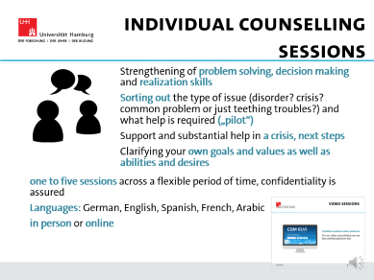
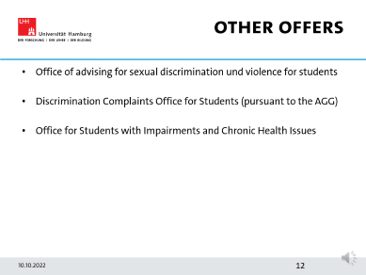
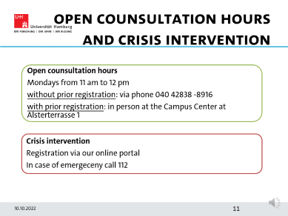
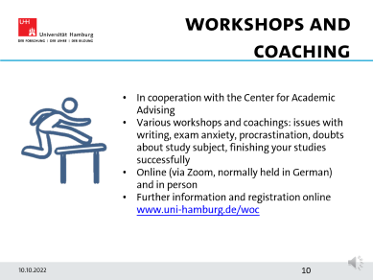
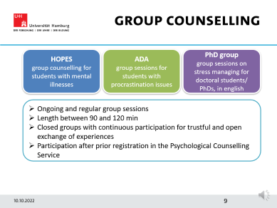
Our offers
Notes:
We offer a variety of individual and group coachings as well as workshops, that I will now tell you a bit more about.

Slide 7

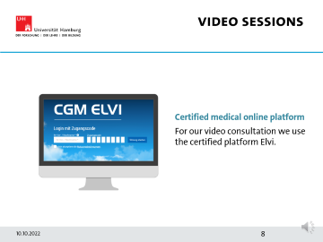

Individual counselling sessions
Strengthening of problem solving, decision making and realization skills
Sorting out the type of issue (disorder? crisis? common problem or just teething troubles?) and what help is required („pilot“)
Support and substantial help in a crisis, next steps
Clarifying your own goals and values as well as abilities and desires
one to five sessions across a flexible period of time, confidentiality is assured
Languages: German, English, Spanish, French, Arabic
in person or online
Notes:
In individual coaching sessions we are looking more closely into one or a few issues that you want to discuss. Our goal is to strengthen your problem solving and decision making skills and support you in activating your resources. We can also clarify if you are suffering from a mental illness or not. If necessary we can help you find further help, like therapy. In times of crises, we act as stabilizers and plan necessary next steps with you to get you out of the pit. We can provide up to five individual sessions. We can schedule the sessions flexibly, like every two weeks or even once a month. All of our consultants are legally bound to keep everything you tell us (including the fact that you are seeking help) confidential, which means we will neither talk about it within the university nor outside of it. We offer coaching in different languages and online as well as face-to-face.

Slide 8

Video sessions
Certified medical online platform
For our video consultation we use the certified platform Elvi.
Notes:
When working online, we are using a platform that is also being used by other health services. The platform provides better protection of your data.

Slide 9
Group Counselling
HOPES
group counselling for students with mental illnesses
ADA
group sessions for students with procrastination issues
PhD group
group sessions on stress managing for doctoral students/ PhDs, in english
Ongoing and regular group sessions
Length between 90 and 120 min
Closed groups with continuous participation for trustful and open exchange of experiences
Participation after prior registration in the Psychological Counselling Service
Notes:
We offer different group sessions.
HOPES is a group for students with mental illnesses. Especially when you want to restart your studies after a long absence or stay in a psychiatric hospital, this group can provide you with valuable suggestions and support to handle the daily life of a student with a mental illness.
ADA is short for Begin – Stick to it – Check it off. It is a group where students with strong tendencies to procrastinate deal with target setting, facing your inner critic and how to start and finish projects.
As of last semester, we now also offer a group for PhD students in English. This group focuses on stress management.
All of these groups get together regularly for 90-120 minutes. They are closed, with the same people participating over the course of the semester. This creates a safe, open and honest environment.
If you are interested in one of these groups, please register with the Psychological Counselling Service and we will meet you to discuss your participation.

Slide 10

Workshops and Coaching
In cooperation with the Center for Academic Advising
Various workshops and coachings: issues with writing, exam anxiety, procrastination, doubts about study subject, finishing your studies successfully
Online (via Zoom, normally held in German) and in person
Further information and registration online www.uni-hamburg.de/woc
Notes:
In cooperation with the Centre for Academic Advising, we offer a variety of workshops and coachings. For example on learning strategies, time management, exam anxiety or relaxation techniques and mindfulness. All of the workshops are free of charge. Most of them are held via Zoom but we’re starting to offer face-to-face workshops again.

Slide 11
Open Counsultation Hours and crisis intervention
Open counsultation hours
Mondays from 11 am to 12 pm
without prior registration: via phone 040 42838 -8916
with prior registration: in person at the Campus Center at Alsterterrasse 1
Crisis intervention
Registration via our online portal
In case of emergeceny call 112
Notes:
Every Monday from 11am to noon we offer open consultation hours. You can either call us without prior registration or just show up at the Alsterterrasse 1 after registering online. In 10 to 15 minutes we will try to understand your concerns and develop steps you can take. When you face a crisis please register with our online services and ask for a consultation. In cases of emergency dial 112.

Slide 12
Other Offers
Office of advising for sexual discrimination und violence for students
Discrimination Complaints Office for Students (pursuant to the AGG)
Office for Students with Impairments and Chronic Health Issues
Notes:
The Office of Advising for Sexual Discrimination and Violence for Students is also part of the Psychological Counselling Services of Hamburg University. If you yourself fall victim to sexual discrimination or violence or if you witness someone else being harassed or violated, here is a place where you can find relief, support in coping and suggestions of steps you can now take. We will support you in finding a way to handle what happened within the university context as well as outside of it. You might further find help at the Discrimination Complaint Office for Students (part of the Centre for Academic Advising) or at the Office for Students with Impairments and Chronic Health Issues where you can be advised on academic adjustments and compensations the university can offer you.

Slide 13


A Good start despite corona restrictions?
Keep control and stay organised in difficult times
Set realistic goals despite online conditions
Improve your time management, semester and weekly planning
Use daily structures
and routines
Celebrate fulfilment and reward yourself
Stay active
Keep activities you liked before
Move
Meet new people, even if only online. Team up in pairs for studying.
Be mindful and relax
Set a limit for your media consumption
Use support offers early
Use other counselling services (BESI/ Studierendenwerk, Studienfachberatung)
Address problems with your professor or tutor as soon as you experience difficulties
Talk to other students
Notes:
So, what can you do to start your studies successfully? Become active.
Important is to keep control and stay organized. In order to achieve this, it is key to plan your student life realistically, keeping in mind personal as well as university factors. Studying online demands very different planning than going to the lecture hall. Work on your time management, starting with a realistic plan for the semester and for the week. Daily structures and routines make it easier, so try and implement them. And don’t underestimate the positive effect of celebrating your achievements, so make sure you reward yourself every once in a while for having finished a task.
Keep doing what is good for you. Find time to do whatever made you feel good, relaxed, energized and balanced in the past but also try new things. Exercising or moving in general is great after (or before) a day of sitting and thinking, whereas the consumption of media often doesn’t really help. So set yourself limits. Try to find time slots for relaxation and mindfulness in your life.
Last but not least: invest in building a social network and make use of the help that is being offered by the university. There are lots of different counselling services to support you with whatever issue or concern you might have. Don’t be shy in making contact. Get in touch with your professors early, so they can help you when questions come up. And most of all: get to know your fellow students! Successful studying often relies on teamwork.

Slide 14

Contact us
…Online
www.uni-hamburg.de/psychologischeberatung
Notes:
How can you get in touch with us? www.uni-hamburg.de/psychologische-beratung will get you there straight away. Use the menu bar to find your way around and register with us.

Slide 15
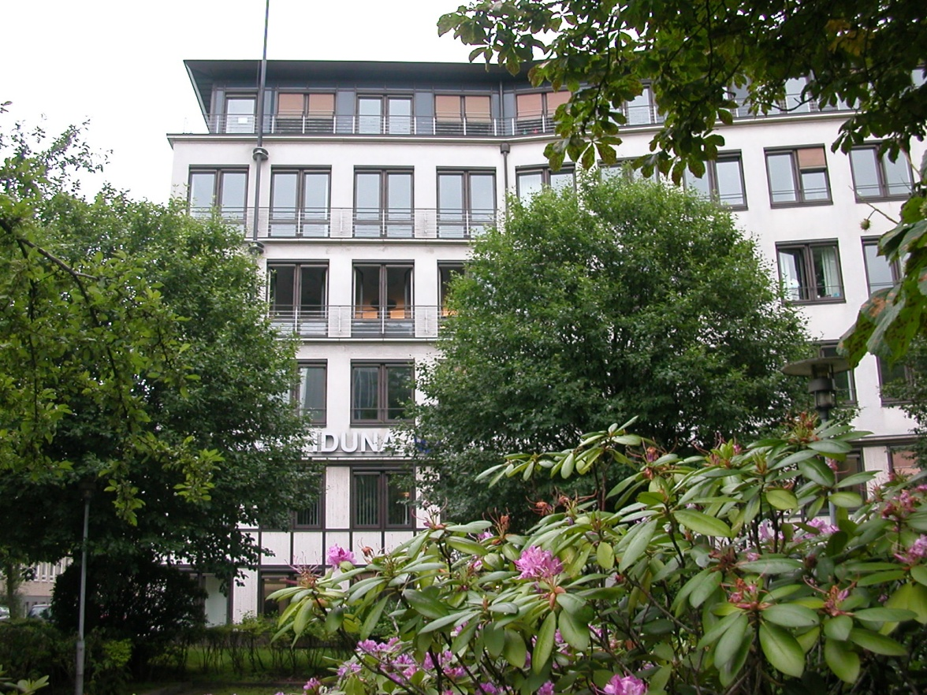
Contact us
…in person
Alsterterrasse 1
20354 Hamburg
3./4. OG
Notes:
To meet up face-to-face, come visit us on the 3rd and 4th floor of Alsterterrasse 1. That’s the same location as the Campus Centre, opposite the Dammtor station. We’re looking forward to meeting you!

Slide 16
Thank you for listening!
We wish you a good start
at University of Hamburg!
Notes:
Have a great start at the university! If you have any questions or queries, don’t hesitate to get in touch. Thanks for listening.

